Slide 1
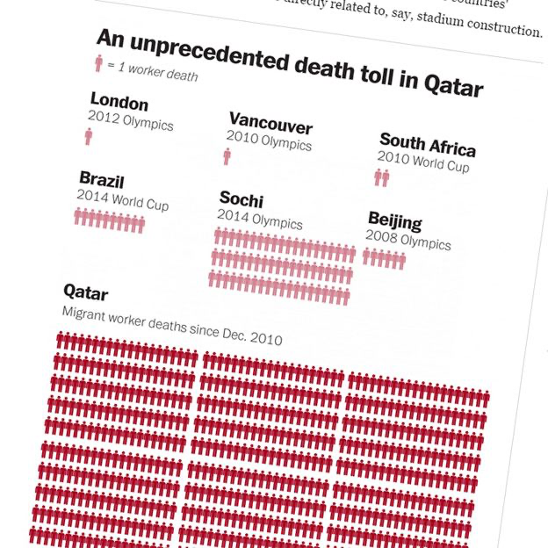
OBJECT DETECTION
CONSTRUCTION WORKERS’ SAFETY ENSURANCE

Slide 2
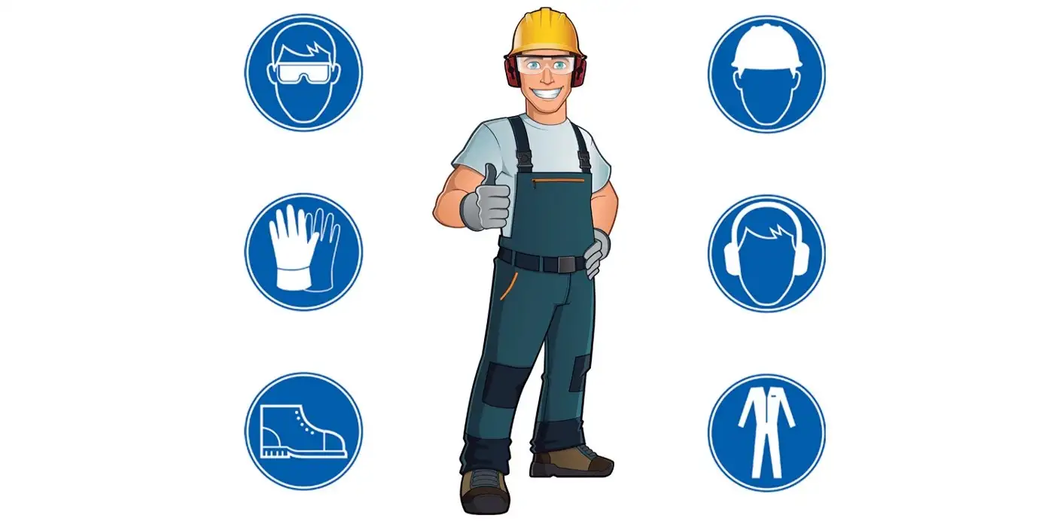
Project Outline
Our project aims to mitigate the issue of fatal construction accidents , error-prone traditional manual supervision and the shortage of qualified site inspectors which is augmented by adopting an AI-based-smart-construction safety-inspection protocol.
Our primary goal is to develop a model that would identify an individual construction worker and detect the type of safety gears the worker is wearing.
We proposed detection safety conditions based on three combinations of PPEs in the form of hardhats/helmets,vests and glasses.

Slide 3
Index
Abstract
Business Use Case
Concepts Used
Our Data
How we processed data?
Algorithms Used
Comparison of models
Optimal case
Diagram(s) or Visualization(s)
Final Recommendation
Challenges faced
Future Enhancements
Demo

Slide 4
TEAM-11!
1.Joshua Bobby(II-Year ,CSE - Core, SRM, KTR)
Role - Background Research
2.Solomon Abhilash Martin(III-Year , CSE-Core ,VIT Vellore)
Role - Background Research , Data Collection
3.Shreyas Singh(III-Year , CSE-Core ,VIT Vellore)
Role - Deployment
4.Gayatri Malladi(III-Year , CSE-SWE,SRM KTR)
Role - Deployment
5.Damian Lourdes(IV-Year , CSE-Core ,VIT Chennai)
Role - Background Research
6.Hitesh Goyal(IV-Year , CSE-AI/ML ,VIT Chennai)
Role - Object detection

Slide 5
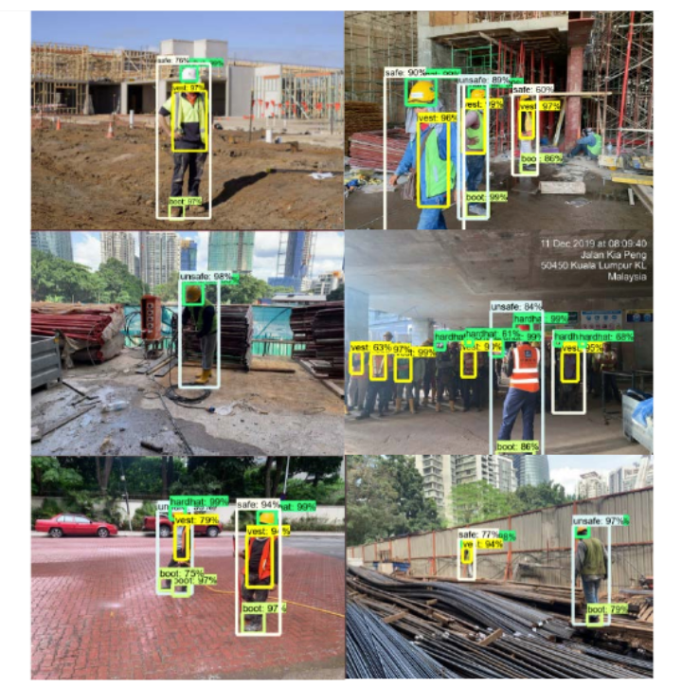
What we are trying to build?
We are trying to develop a AI-based novel smart safety detection technique able to monitor workers working at construction sites by using real time object detection algorithms.
We are implementing algorithms such as CenterNet , Faster R-CNN and Single-Shot-Detection(SSD) which would help us find the best model with good accuracy.

Slide 6
Abstract
The safety of workers at construction sites is one of the most important aspects that should be considered while performing their required tasks. The Occupational Safety and Health Administration (OSHA) reported that one in ten construction workers are injured every year falls , electrocutions, being struck-by-objects and being caught in or between an object were the four main causes of worker deaths on construction sites.
The presented model contains a dataset of 4,500 images from PictorPPE as a training dataset, from real construction sites for evaluation purposes. Out of which 1,500 images are annotated and rest images are used for testing and evaluating purposes.
The obtained results verify the effectiveness of our proposed model in construction sites to control potential violations and to avoid unnecessary accidents

Slide 7
Business Use Case
It follows a Business to Business model.
Our clients will be contractors, who deal, manage and absorb the risks related to manual labour, as well as the construction companies who have to implement the strict safety regulations.
Customization based pricing.
Subscription Based, with monthly and annual plans.
Initial cost of setup required will be approx. ₹11,000 (162.5 SGD)[₹800+₹9300]

Slide 8
Important Use Case
Actors-Construction Corporation,Labour Contractors-Customers, Business Manager and Developer
System-It includes the working and interaction of website with the actors.
Goals-The end result of most of the use cases.The goal is to detect the safety equipment of workers and create a checklist that would check the eligibility of worker safety to enter the construction site.

Slide 9
Risk Analysis
Risk Identification:
Server Crash
ESP-32 Cam hardware issue
Network Issue
Risk Analysis:
Server Crash: The probability of a server crash is low, microsoft azure has had an uptime of 99.995%
ESP-32 Cam Hardware Issue: The ESP-32 Cam is inexpensive can easily be replaced and reconfigured
Network Issue: In the recent years, expansion of network coverage areas have made it possible, to connect even remote areas, with internet, although at times there could be momentary disruptions in the connectivity, which will ideally be resolved quickly.

Slide 10
Concepts Used
CNN translates to Convolutional Neural Networks which is a very popular algorithm for image classification and typically comprises of convolution layers, activation function layers, pooling (primarily max_pooling) layers to reduce dimensionality without losing a lot of features.
In object detection, RPN is the one true backbone and have proven to be very efficient till now. It’s purpose is to propose multiple objects that are identifiable within a particular image.
In image classification tasks, we assume that there is only one major object in the image and we only focus on how to recognize its category. However, there are often multiple objects in the image of interest. We not only want to know their categories, but also their specific positions in the image. In computer vision, we refer to such tasks as object detection (or object recognition).

Slide 11
Concepts Used
Image Classification: Image classification involves predicting the class of one object in an image. Object detection combines these two tasks and localizes and classifies one or more objects in an image.
Input: An image with a single object, such as a photograph.
Output: A class label (e.g. one or more integers that are mapped to class labels).
Object Localization: Locate the presence of objects in an image and indicate their location with a bounding box.
Input: An image with one or more objects, such as a photograph.
Output: One or more bounding boxes (e.g. defined by a point, width, and height).
Object Detection: Locate the presence of objects with a bounding box and types or classes of the located objects in an image.
Input: An image with one or more objects, such as a photograph.
Output: One or more bounding boxes (e.g. defined by a point, width, and height), and a class label for each bounding box.

Slide 12
Our Data
A simple object detection dataset contains images along with their annotations. The annotations contain metadata which means they have data which can help us recognize which image contains what objects and where.
Annotations can be in different formats based on the dataset collector but they can be standardized into a format known as Pascal VOC XML. Through this format it becomes easier to convert the dataset for model training.

Slide 13
How we Processed Data
The dataset used is Pictor which is benchmark dataset and has been used by multiple research papers. This dataset is not in Pascal VOC and must be converted through pre-processor.
The dataset we used is Pictor-V3.It contains 774crowd sourced images and 698 web-mined images. In total they contain about 4,700 instances of workers.
The dataset contains annotations in text form which needs to be processed into TensorFlow record format. Other than that the training pipeline is setup along with data augmentation techniques like Horizontal flip and Random cropping.
This study also created a novel dataset named CHVG(four colored hardhats, vest, safety glass) containing eight different classes, including four colored hardhats, vest, safety glass, person body, and person head)
The dataset contains 1,699 images and corresponding annotations of these eight classes.
The image size of the dataset is 640 × 640. The dataset can be found https://doi.org/10.6084/m9.figshare.19625166.v1

Slide 14
Algorithm Used
Single Shot detector(SSD)
In this algorithm, the image is passed to RESNET50,which is a CNN architecture. This gives us a feature map of the bounding boxes.
The SSD consists of 6 convolutional layers which creates 8,732 bounding boxes for each object. As we are forming a large number of bounding boxes there can a scenario of intersection. To avoid this intersection so we use non-max suppression to remove the duplicates and choose the top 200 bounding boxes.
Now we compare the bounding boxes with brown truth box in order to measure the intersection of over union which determines how much of the bounding box overlaps with the ground truth box.
The bounding box with highest IOU is considered as a part of the result.

Slide 15
Algorithm Used
Faster R-CNN
In this algorithm, first we pass the image to the region proposal network which will differentiate the foreground from the background and in turn determine the corresponding bounding boxes.
Steps within the RPN are as follows:
Generation of anchor boxes-Anchor boxes are the bounding boxes which determine where the object is in the image.
This network uses anchor boxes of various sizes in order to determine the object better. These bounding boxes are then compared with the ground truth box to determine the IOU.
All those bounding boxes which have an IOU>0.5 are categorized as foreground while the rest are categorized as background.

Slide 16
Algorithm Used
v. Those boxes which are categorized as foreground are sent to Region Proposal layer such as RESNET50.This layer gives us the feature map of the respective bounding boxes which the output of RPN.
Region of Interest Pooling-Here we receive the feature vector as input, as our feature map consists of bounding boxes of various sizes the ROI normalizes these into a common size.
These are then sent to a classifier which will then determine if area detected is an object or background.
The regressor then creates the resulting bounding box.

Slide 17
Algorithm Used
CenterNet
Architecture-Represents an object as a point called a key point. This is the bounding box centre.
The model takes an input image of width w and height h and outputs a prediction of floor ([w/R],[h/R]) where R=model output stride(ratio of input image size to output feature map size)
It has 3 heads.Key point heatmap[c](values are assigned using an exponential distance. The object centre heat map value is 1 and decreases exponentially as moves away from object centre.
During heat map operation Due to output stride and floor operation multiple pixels from input image map to same pixel on the output heat map to get the final predictions we have to scale up the heat map back to the original image dimensions.
But the scale up operations will lead to precision errors upto R-1 pixel .Local offset prediction fixes this error.It has depth of 2 to fix both x and y coordinate offset

Slide 18
Algorithm Used
For workers safety- detects objects as points so it treats key points as classes and generate heatmap for each class. For one person combine heatmap and offset will give praise location of all key points of a single person.When there are multiple persons it’s difficult even with multiple key points..
Solution-joint location prediction(K*2) is crucial. It predicts location of key points for corresponding object centre. It is less accurate than heatmap plus offset prediction.

Slide 19
Comparison of Models
ALGORITHMS USED | AVERAGE PRECISION | AVERAGE LARGE | AVERAGE RECALL | AVERAGE RECALL LARGE
FASTER R-CNN (ON CHVG) | 30.3% | 45% | 42.8% | 57.6%
FASTER R-CNN (ON PICTOR) | 9.1% | 22% | 26.8% | 46.3%
SINGLE-SHOT-DETECTI(ON CHVG) | 10.7% | 14.9% | 32.9% | 39.1%
SINGLE-SHOT-DETECTION (ON PICTOR) | 30.4% | 45.7% | 62.2% | 60.2%
CenterNet (over CHVG) | 53.8% | 65.9% | 65.9% | 65.9%
CenterNet(over pictor) | 30.4% | 45.6% | 41.2% | 60.2%

Slide 20
Optimal Case
Our best performing model is CenterNet with a RESNET -50 backbone.It has a precision of 30.4% on PictorV3 and 53.8% in CHVG.
It is the best performing model on both datasets and performs exceptionally better at a lower computational requirement.
It is also ideal because of its exceptional precision and recall on large images which is most relevant to our business.

Slide 21
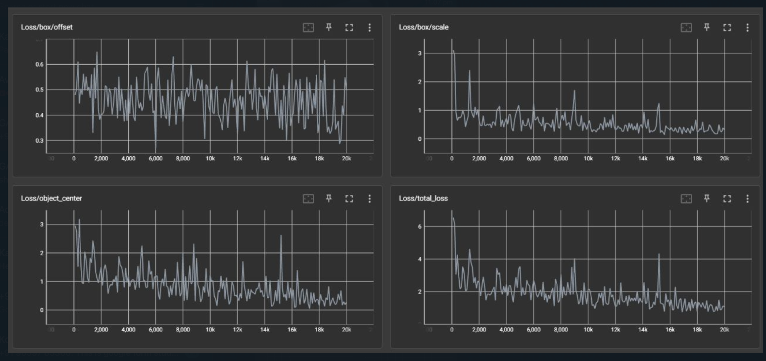
Diagram(s) or Visualization(s)
Centernet(CHVG)
Centernet

Slide 22
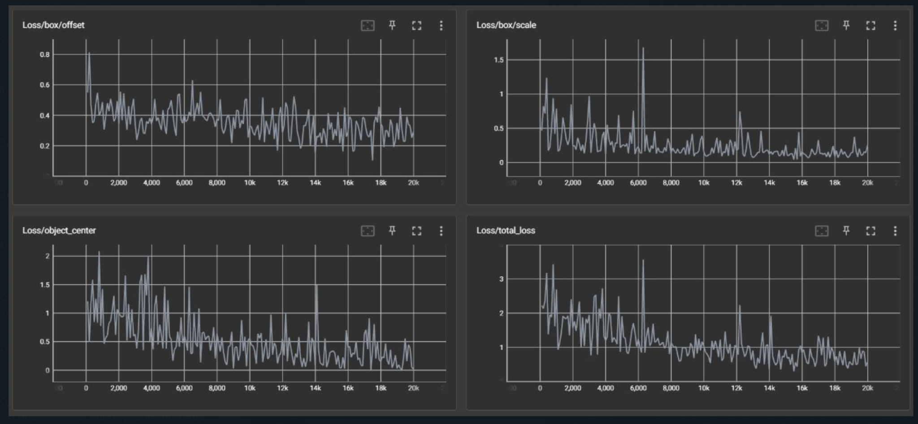
Diagram(s) or Visualization(s)
Centernet(PICTOR)
Centernet

Slide 23
Diagram(s) or Visualization(s)
SINGLE-SHOT-DETECTION(CHVG)
Centernet

Slide 24
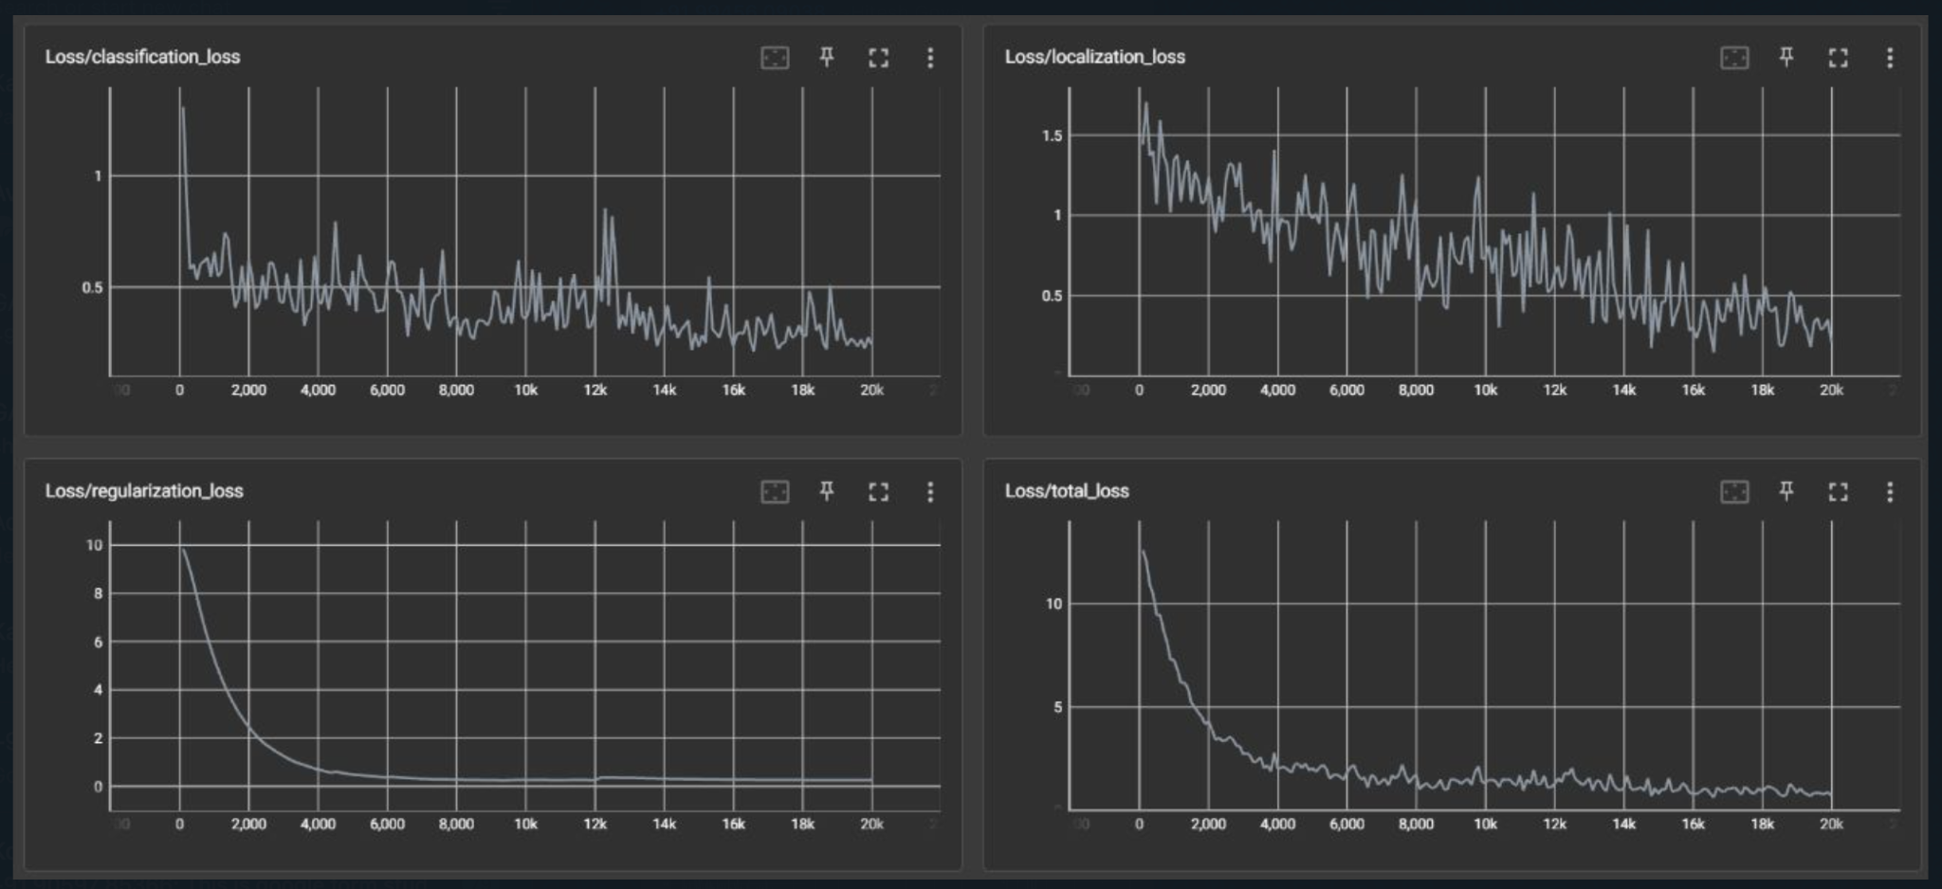
Diagram(s) or Visualization(s)
SINGLE-SHOT-DETECTION(PICTOR)
Centernet

Slide 25
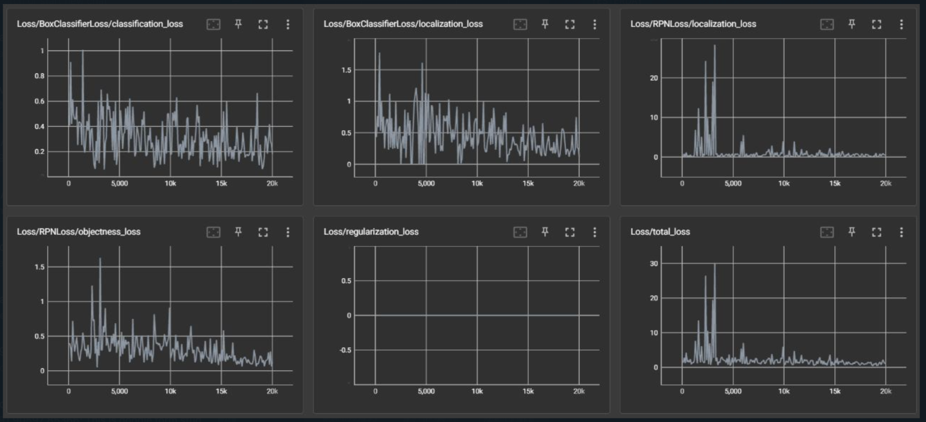
Diagram(s) or Visualization(s)
FASTER-RCNN(CHVG)
Centernet

Slide 26
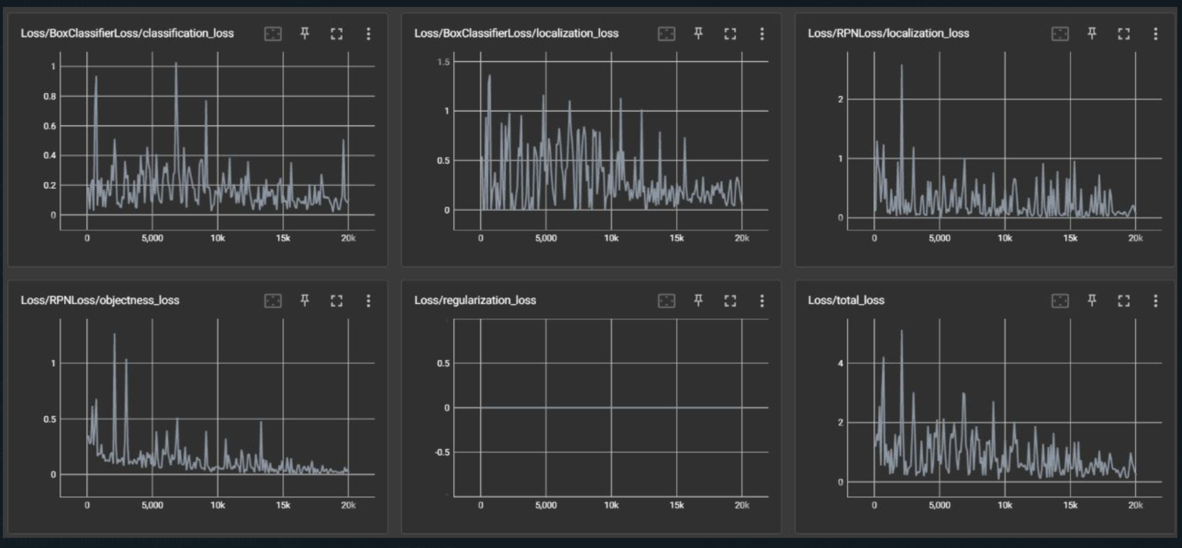
Diagram(s) or Visualization(s)
FASTER-RCNN(PICTOR)
Centernet

Slide 27
Final Recommendation
The best model with good accuracy results on training is CenterNet.
It is the best performing model on both datasets and performs exceptionally better at a lower computational requirement.
It is also ideal because of its exceptional precision and recall on large images which is most relevant to our business.

Slide 28
Challenges Faced
One of the biggest challenges in making an object detection model is to configure an API and the dataset. Doing this on TensorFlow males the task more comfortable but due to the various compatibility issues of the libraries the task is still a challenge.
An object detection model is much more complex than an image classification model and making one end to end model can be especially be difficult without clear knowledge.
Object detection is not just complex in understanding but is also highly computationally expensive. This means running it on a local computer can be an especially and tedious task.
Construction gear detection is not a very commonly performed task making its datasets especially sparse.
To be able to make an industry level implementation it is important to be supported by a big company which can provide the required resources.

Slide 29
Our Learning
Through thus project we were able to learn that we are much more capable than what we are.Being able to implement and deploy an object detection task in 1.5-2 weeks shows that when we are pushed to our limits we can outperform ourselves and come out stronger, resilient and knowledgeable.
We learnt AI concepts like object detection using CNN, transfer learning, data augmentation. We also learnt Django, HTML, CSS, JavaScript which are different parts of full stack development.
Other than this we learnt about the most important thing in any project, team work. To work as a team the team members must forget their differences and work as a common body towards a common goal. For this all teammates must bond and learn how to empathise with one another so that team can work as single unified body.

Slide 30
Future Enhancements
Since our model is trainable as well as scalable we will be able to add more equipment parameters such as Gloves, Shoes, Mask and other relevant parameters for workers’ safety insurances.
Also since our model is more dynamic it can be implemented to other fields of work. For example our model can be widespread to hospitals where it can detect PPEs of hospital staffs.
We can use a better architecture and provide it as a premium service for critical requirements in the industry.
We can use cloud training resources to train a more robust model.

Slide 31
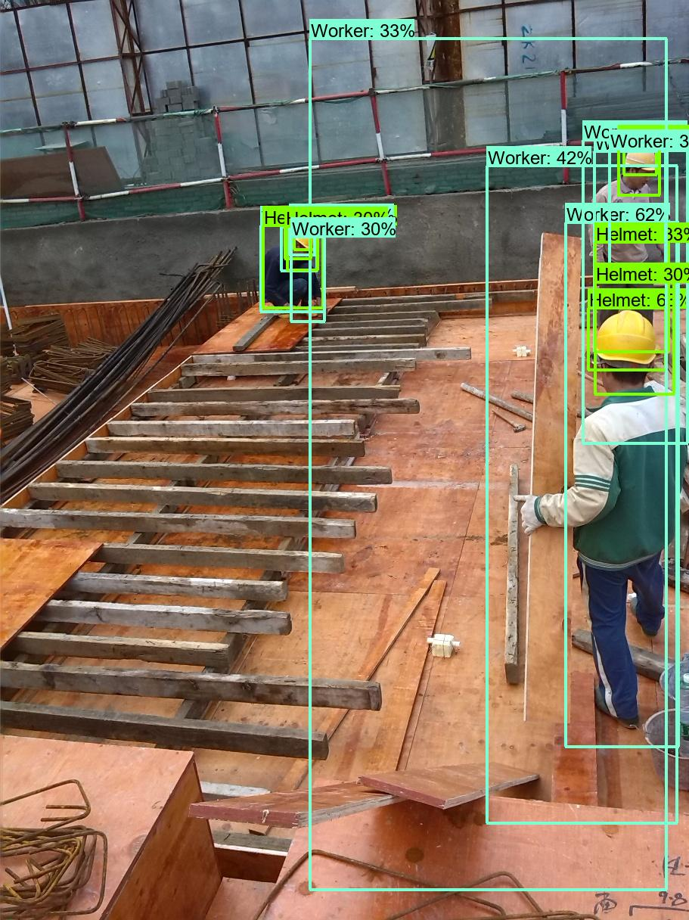
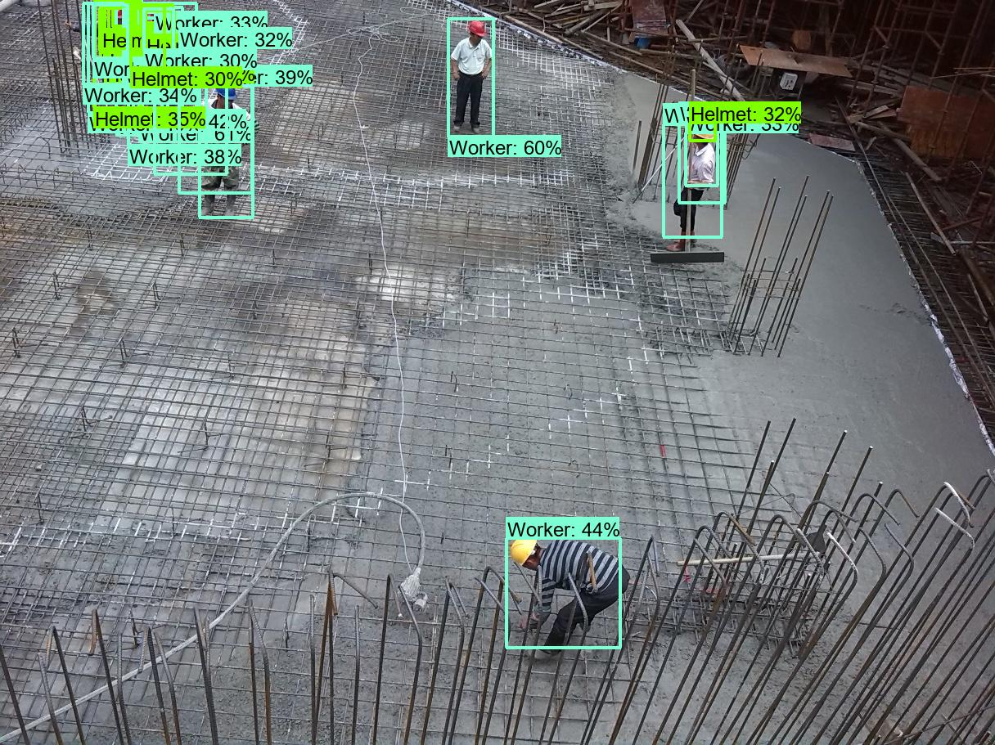
Demo

Slide 32
TEAM-11
Thank You

